Slide 1
C# Professional Level 1
OOP Fundamentals

Slide 2
What is OOP ?
OOP stands for Object-Oriented Programming, which is a way of writing computer programs that focuses on creating and using objects.
An object is like a real-world object or concept that has properties and behaviors. For example, a car is an object that has properties like color, model, and speed, and behaviors like accelerating, braking, and turning.
In Object-Oriented Programming, you define a class that describes the properties and behaviors of an object. Then you can create instances of that class, which are individual objects that have their own values for the properties and can perform the behaviors defined by the class.

Slide 3
Explain with sample
For example, you could define an Employee class that has properties like Name, Firstname, and behaviors like GetFullName or CalculateSeniority. Then you could create instances of that class for different employee, like a former employee or new employee.

Slide 4
4 Pillars of OOP
Inheritance
Polymorphism
Abstraction
Encapsulation

Slide 5
OOP Pillars - Abstraction
Abstraction
Abstraction and encapsulation go hand in hand in the process of simplifying complexity, Think of it as a small set of public methods which any other class can call without “knowing” how they work
With abstraction, only the things we need to see, and use are shown to us
Abstraction is external, hiding other irrelevant information
Notes:
Example : public class Vehicle { private string _model; public string GetModel() { return _model; }
….
}

Slide 6
OOP Pillars - Encapsulation
Encapsulation
All the complexity is hidden
Encapsulation is internal, goes hand in hand with abstraction
Binding data members and methods together to achieve and maintain data consistency and integrity
Implemented through the concept of class
Example: Vehicle
Contains all required elements to work: engine, radiator, exhaust
Binds all components together to make the vehicle work
Notes:
In C#, encapsulation is achieved through the use of access modifiers, such as "private," "protected," and "internal."
"private" members of a class can only be accessed within the class itself.
"protected" members can be accessed within the class and any derived classes.
"internal" members can be accessed within the same assembly.
By default, members of a class are private.
Example :
class Car {
private int speed;
public int Speed
{
get { return speed; }
set { speed = value; }
}
...
}

Slide 7
OOP Pillars - Inheritance
Inheritance
A way to reuse the common logic and extract the unique logic into a separate class
Extending the features or behavior of an existing object through a new object
The child class reuses all fields and methods of the parent class (common part) and can implement its own (unique part)
Improves reusability of code and objects and avoids duplication
Example: Employee
Notes:
Employee is an abstraction of Trainee and Consultant because both have Name, FirstName, Id, Address and HireDate in commons (only the values are different).
But we have two other classes, Trainee and Consultant as each of these classes have their own specificities.
The Trainee may have an Internship Tutor
A Consultant use to have a supervisor as well as a Business Unit
These attributes are specific to each specific classes, but the common attributes are defined only once in the Employee class.
Using inheritance, the Trainee and Consultant classes don't have to redefine these properties.
By definition we can say that a TRAINEE class is an EMPLOYEE and that a CONSULTANT class is also a EMPLOYEE

Slide 8
OOP Pillars - Polymorphism
Polymorphism
Promotes flexibility in designs by allowing the same method to have multiple implementations with the same name
The two types of polymorphism are Dynamic and static
Method Overloading: Compile time polymorphism, involves having another method with the same prototype, more than one method in your class with identical names but varying parameters for example
Method Overriding : Run time polymorphism, known as redefinition or method overriding (using virtual methods and inheritance): change the behavior of the method for the derived class
Example: Employee
The same object can fulfill multiple roles
Allows to manage different type of Employee as well as relationship in company
Notes:
namespace OOP
{
public class Person
{
public string Name { get; set; }
public string FirstName { get; set; }
public Person(string name, string firstName)
{
Name = name;
FirstName = firstName;
}
public string GetFullName(string name, string firstName)
{
return String.Join(' ', name, firstName) ;
}
public virtual string GetFullName()
{
StringBuilder stringBuilder= new StringBuilder();
stringBuilder.AppendJoin(' ', Name, FirstName);
return stringBuilder.ToString();
}
}
public class Employee : Person
{
public string Id { get; }
public int Salary { get; set; }
public Employee(string id, int salary, string name, string firstname):base(name, firstname)
{
Id = id;
}
public override string GetFullName()
{
return Id + " " + base.GetFullName();
}
}
}

Slide 9
Inheritance in C#

Slide 10
Inheritance
Create new classes that reuse, extend, and modify the behavior that is defined in other classes
The class whose members are inherited is called the base class
The class that inherits those members is called the derived class
A derived class can have only one direct base class
Use keyword « sealed » to prevent inheritance (for a class, on an overridden method)
Notes:
Substitutability is a principle in object-oriented programming stating that, in a computer program, if S is a subtype of T, then objects of type T may be replaced with objects of type S (i.e. an object of type T may be substituted with any object of a subtype S) without altering any of the desirable properties of T (correctness, task performed, etc.)
Sealed can be considered for performance purpose, but one should take consideration that this would limit extensibility.

Slide 11
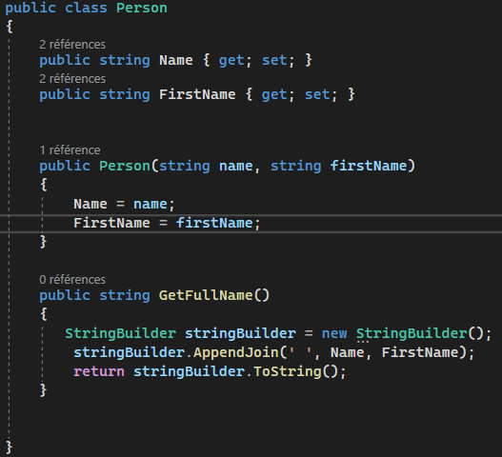
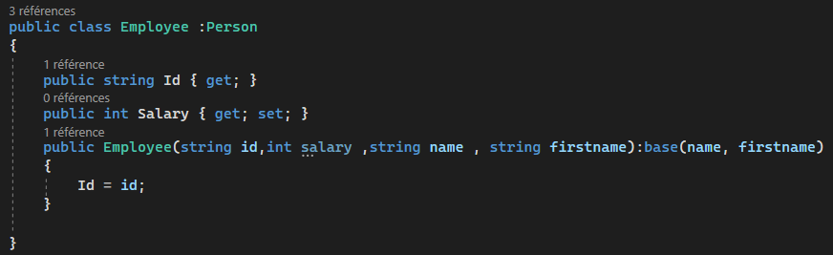
Inheritance
The base class
The derived class
The base class constructor

Slide 12
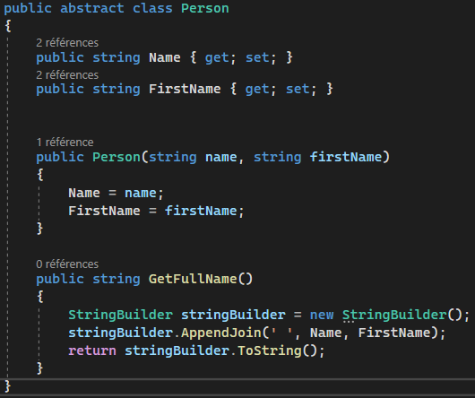
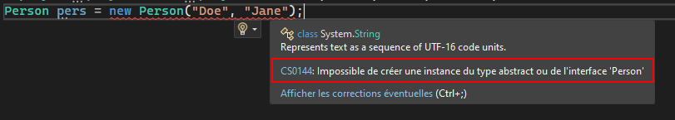
Inheritance – abstract classes
Abstract classes can have non implemented members (abstract keywords)
All abstract members are virtual (see later in polymorphism)
Abstract classes can’t be instantiated

Slide 13
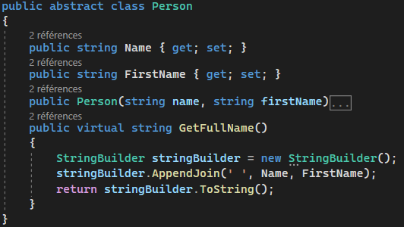
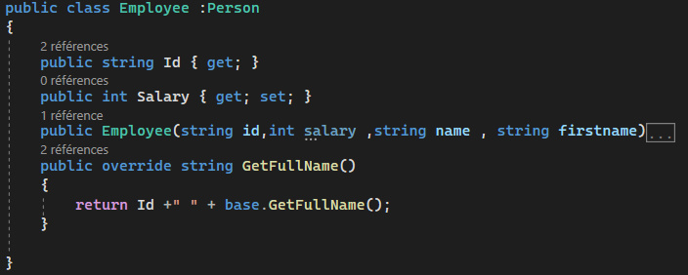
Overriding
Method, Properties, Indexers: everything with code
« virtual » & « override » keywords
There is a « new » keyword to hide base method: DO NOT USE IT.
Use « base » keyword to access the base method

Slide 14
Interfaces
Keyword: interface
An interface contains definitions for a group of related functionalities that a class or a struct can implement.
Interfaces can contains:
Methods
Properties
Events
Indexers
All members are public
An interface does not contain implementation
A class, a struct, or even a interface can implement several interfaces
All members needs to be implemented by the implementer
The interface name should start with I, then pascal case: IEnumerable, IDisposable
Create Interfaces for specific purpose, no big interface with several roles

Slide 15
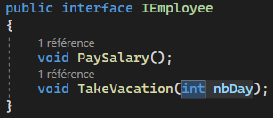
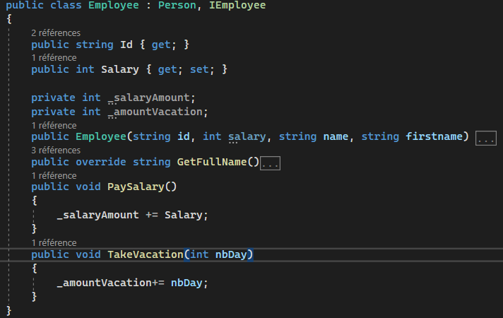
Interfaces

Slide 16

Demo
Inheritance
Notes:
See README.md on the Inheritance project of Csharp_DemoOOP repository

Slide 17
SOLID Principles

Slide 18
SOLID Principles
S
O
L
I
D
Single Responsibility
Open / Close Principle
Liskov Substitution Principle
Interface Segregation
Dependency Inversion
A class has one single responsibility and therefore one reason to change
Open for extensions, closed for modifications.
Subtypes must be substitutable for their base type.
Not one ‘big’ interface for all clients, but one interface per kind of client.
High-level modules should not depend on low-level modules.
Notes:
These principles are for better Object Oriented (OO) design. All of these principles lead to smaller classes, with clear responsibilities, that are easy to extend and hard to break. They lead to more easily-testable code. All of these things are important for scrum, since they help us write quality code. Combine that with a proper level of documentation in the code and proper naming and you've reached easily maintainable code.
Teams that don’t understand these principles (or at least don't follow them very well) can succeed as well. Some teams may try to use these principles and their flow grinds to a halt, so they're not the holy grail. Especially when you have a lot of less senior developer or developers with a non-OO background.
For other non-OO programming paradigms, similar principles exist, but they are beyond the scope of this course. So when you do VB6, F#, PHP or something else, you can still write highly maintainable code, but will probably not use some of these principles. Going to deep into this topic is rat hole.

Slide 19
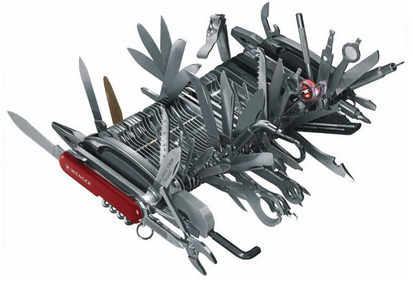
Single Responsibility
A class should have one and only one responsibility
Class should only have one reason to change
Can be verified with cohesion in class
Measure the strength of relationship between class members
Available as LCOM4 in Ndepend or Sonar
LCOM4 = 1: The class is a solid component with all methods and fields related
LCOM4 > 1: The class can be split to different classes
LCOM4 = 0: The class has no methods
Just because you can, doesn’t mean you should…

Slide 20

SOLID
Multiple responsibilities
Single Responsibility
public class BankAccount
{
public string AccountNumber { get; set; }
public decimal AccountBalance { get; set; }
public decimal CalculateInterest() {
return 42M;
}
}
public interface IBankAccount {
string AccountNumber;
decimal AccountBalance;
}
public class BankAccount : IBankAccount {
public string AccountNumber { get; set; }
public decimal AccountBalance { get; set; }
}
public interface IInterestRateCalculator {
decimal CalculateInterest(IBankAccount account);
}
public class InterestRateCalculator : IInterestRateCalculator {
public decimal CalculateInterest(IBankAccount account) {
return 42;
}
}
Notes:
Single Responsibility Principle
The Single Responsibility Principle (SRP) states that every class should have a single responsibility, and that responsibility should be entirely encapsulated by the class. All its services should be narrowly aligned with that responsibility. A “responsibility” is a reason to change and a class or module should have one, and only one, such reason to change.
As an example, consider a module that compiles and prints a report. Such a module can be changed for two reasons: the content of the report can change or the format of the report can change. These two things change for very different business reasons. One is substantive, and the other is more cosmetic. The single responsibility principle says that these two aspects of the problem are really two separate responsibilities, and should therefore be in separate classes or modules. It would be a bad design to couple two things that change for different reasons at different times.

Slide 21
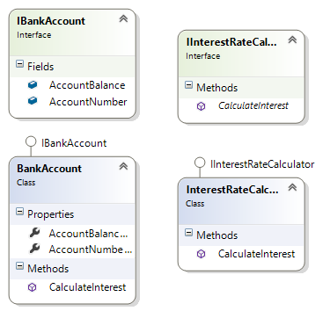
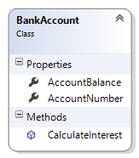
SOLID
Multiple responsibilities
Single Responsibility
Notes:
Single Responsibility Principle
The Single Responsibility Principle (SRP) states that every class should have a single responsibility, and that responsibility should be entirely encapsulated by the class. All its services should be narrowly aligned with that responsibility. A “responsibility” is a reason to change and a class or module should have one, and only one, such reason to change.
As an example, consider a module that compiles and prints a report. Such a module can be changed for two reasons: the content of the report can change or the format of the report can change. These two things change for very different business reasons. One is substantive, and the other is more cosmetic. The single responsibility principle says that these two aspects of the problem are really two separate responsibilities, and should therefore be in separate classes or modules. It would be a bad design to couple two things that change for different reasons at different times.

Slide 22
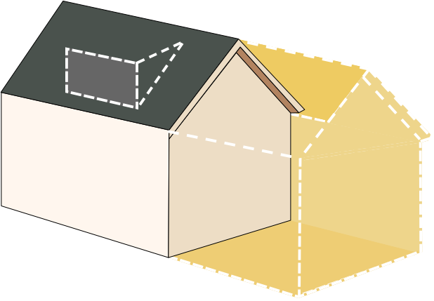
Open / Close Principle
Classes should be open for extension, but closed for modification
Extending your entities correctly
Notes:
Just take a house as an example. If you want to add an extension to your house, you won’t break everything or modify your kitchen !
Keep this in mind for your classes when thinking about adding new properties or methods.

Slide 23
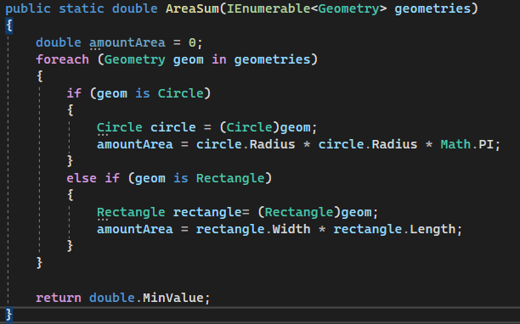
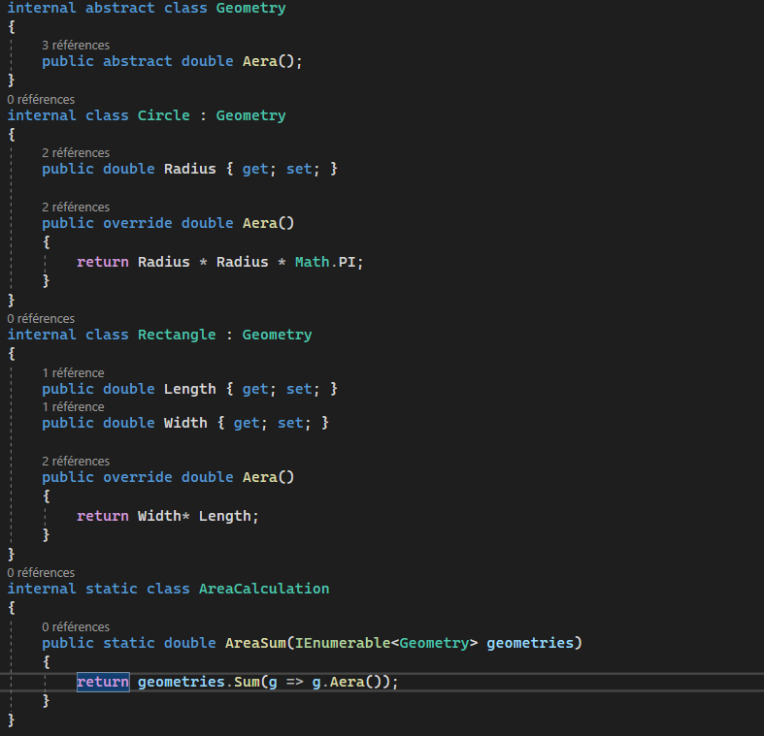
SOLID
Not open for extensions
Open for extensions
Notes:
Open/Closed Principle
The Open/Closed principle states that software classes and methods should be open for extension, but closed for modification. This means that an entity can allow its behavior to be modified without altering its source code. This is especially valuable in a production environment, where changes to source code are very expensive because of testing, code reviews, packaging, and deploying. Code obeying this principle doesn't change when it is extended, and therefore needs no such effort.

Slide 24




Liskov Substitution Principle
Objects in a program should be replaceable with instances of their subtypes without altering the correctness of that program
Notes:
Trying to reload your brand-new Tesla model S with gasoline might be quite ineffective…

Slide 25
SOLID
public interface ICar
{
void Reload();
}
public class Car : ICar {
public void Reload() {
}
}
What happens if we don’t select between Electricity or Gasoline ?
public class ElectricCar : ICar {
public void Reload() {
// Reload logic
}
}
void StartCarReload(ICar car)
{
car.Reload();
}
Notes:
Liskov Substitution Principle
The Liskov Substitution principle states that if Class2 is a subtype of Class1, then objects of type Class1 may be replaced with objects of type Class2. In other words, objects of type Class2 may be substituted for objects of type Class1) without altering any of the desirable properties, such as correctness, tasks performed, etc. The principle says that you should always be able to use a base class or interface instead of the actual implementation and still get the expected result. If you can't, your breaking the principle.

Slide 26
SOLID
Option 1: Without respecting the OpenClose principles
public interface ICar
{
void Reload();
}
public class Car : ICar {
public void Reload() {
}
}
What happens if we don’t select
the correct method to reload ?
public class ElectricCar : ICar {
public void Reload() {
// Reload logic
}
}
void StartCarReload(ICar car)
{
if (car is ElectricCar)
((ElectricCar)car).SetReloadMethod(Refuel.Electric);
car.Reload();
}
void MakeDuckSwim(IDuck duck)
{
duck.Swim();
}
Notes:
Liskov Substitution Principle
The Liskov Substitution principle states that if Class2 is a subtype of Class1, then objects of type Class1 may be replaced with objects of type Class2. In other words, objects of type Class2 may be substituted for objects of type Class1) without altering any of the desirable properties, such as correctness, tasks performed, etc. The principle says that you should always be able to use a base class or interface instead of the actual implementation and still get the expected result. If you can't, your breaking the principle.

Slide 27
SOLID
Option 2: The SOLID approach
public interface ICar
{
void Reload();
}
public class Car : ICar {
public void Reload() {
}
}
public interface ICar
{
void Reload();
}
public class Car : ICar {
public void Reload() {
}
}
public class ElectricCar : ICar {
public void Reload() {
if (!this.IsRefuelMethodSelected)
return;
// Reload logic
}
}
public class ElectricCar : ICar {
public void Reload() {
// Reload logic
}
}
void StartCarReload(ICar car)
{
car.Reload();
}
void StartCarReload(ICar car)
{
car.Reload();
}
Notes:
Liskov Substitution Principle
The Liskov Substitution principle states that if Class2 is a subtype of Class1, then objects of type Class1 may be replaced with objects of type Class2. In other words, objects of type Class2 may be substituted for objects of type Class1) without altering any of the desirable properties, such as correctness, tasks performed, etc. The principle says that you should always be able to use a base class or interface instead of the actual implementation and still get the expected result. If you can't, your breaking the principle.

Slide 28
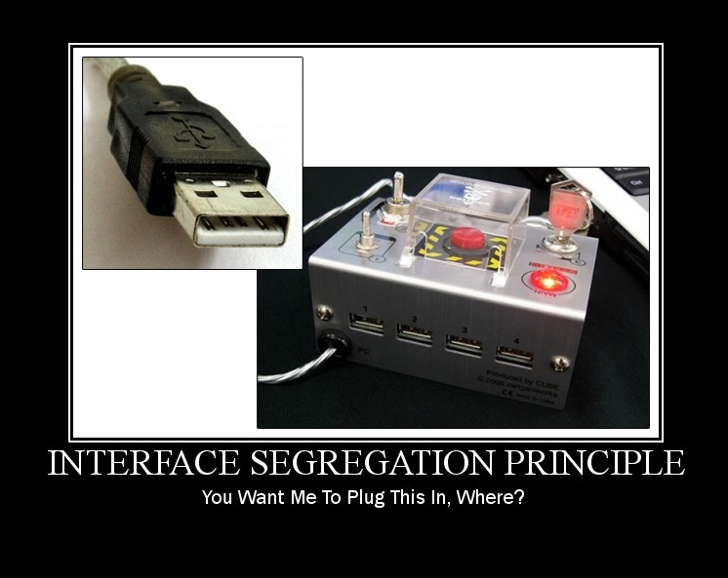
Interface Segregation
Many client-specific interfaces are better than one general-purpose interface
Split interfaces based on their responsibilities
Avoid the « one interface fits all purposes »
Makes code easier to refactor and change

Slide 29
SOLID
public interface IOiseau {
void Voler();
void Pondre();
}
public class Canard : IOiseau {
public void Voler() { // ...
}
public void Pondre() { // ...
}
}
static void FaireVolerLesOiseaux(IEnumerable<IOiseau> oiseaux)
{
foreach (var oiseau in oiseaux)
oiseau.Voler();
}
public interface IOiseau {
void Pondre();
}
public interface IVolatile : IOiseau {
void Voler();
}
public class Canard : IVolatile{
public void Voler() { // ...
}
public void Pondre() { // ...
}
}
public class Manchots : IOiseau {
public void Pondre() { // ...
}
}
static void FaireVolerLesOiseaux(IEnumerable<IVolatile> oiseaux)
{
foreach (var oiseau in oiseaux)
oiseau.Voler();
}
}
public class Manchots : IOiseau {
public void Voler() {
throw new NotSupportedException();
}
public void Pondre() {
}
}
Notes:
Liskov Substitution Principle
The Liskov Substitution principle states that if Class2 is a subtype of Class1, then objects of type Class1 may be replaced with objects of type Class2. In other words, objects of type Class2 may be substituted for objects of type Class1) without altering any of the desirable properties, such as correctness, tasks performed, etc. The principle says that you should always be able to use a base class or interface instead of the actual implementation and still get the expected result. If you can't, your breaking the principle.

Slide 30
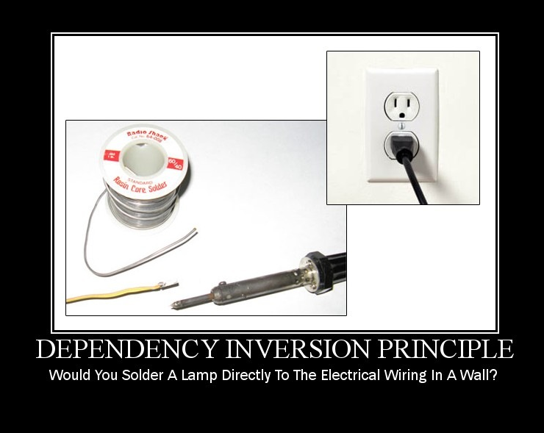
Dependency Inversion
High-level modules should not depend on low-level modules. Both should depend on abstractions

Slide 31
SOLID
Dependency Method
Dependency inversion with injection by constructor
public class CoolSQLRepository
{
public CoolThing GetThing(int id);
}
public class CoolService
{
public CoolThing GetCoolThing(int id)
{
var repository = new CoolSQLRepository();
return repository.GetThing(id);
}
}
public interface ICoolRepository {
CoolThing GetThing(int id);
}
public class CoolService
{
private ICoolRepository repository;
public CoolService(ICoolRepository repository){
this.repository = repository;
}
public CoolThing GetCoolThing(int id) {
return repository.GetThing(id);
}
}
public class CoolSQLRepository : ICoolRepository {
public CoolThing GetThing(int id);
}
Notes:
Liskov Substitution Principle
The Liskov Substitution principle states that if Class2 is a subtype of Class1, then objects of type Class1 may be replaced with objects of type Class2. In other words, objects of type Class2 may be substituted for objects of type Class1) without altering any of the desirable properties, such as correctness, tasks performed, etc. The principle says that you should always be able to use a base class or interface instead of the actual implementation and still get the expected result. If you can't, your breaking the principle.

Slide 32
Guidelines
DO | Use Interfaces to ensure loose coupling between your classes
DO | Make sure that each class has one and only one responsibility
DON’T | Use « fat interfaces » or « god objects »
DON’T | Break the behaviour of a parent class when inheriting

Slide 33

Lab
See instructions in the CSharp_LabOOP project

Slide 34
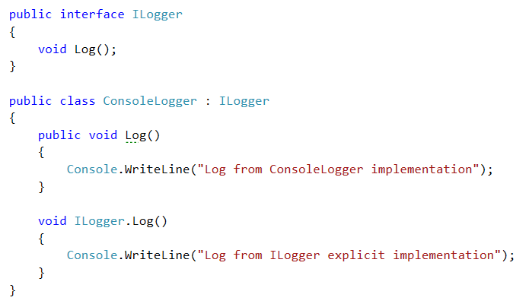
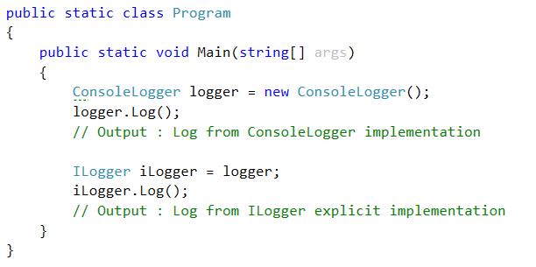
Interfaces – Explicit Implementations
Implementation
Explicit Implementation

Slide 35
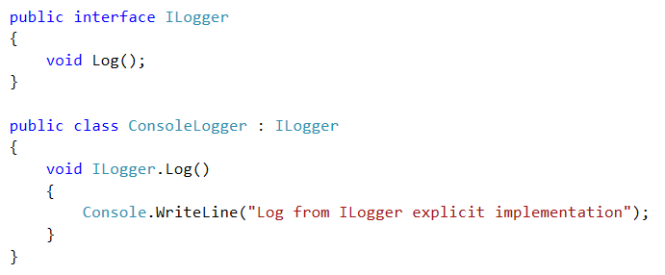
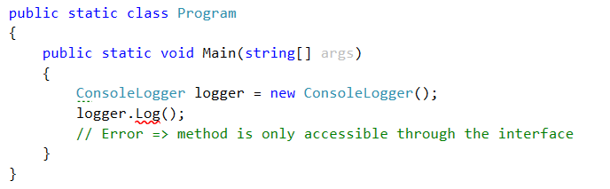
Interfaces – Explicit Implementations

Slide 36
Demo
Interfaces, Interfaces everywhere !
Notes:
Declare and Implement the Ilogger interface with 2 implementations: console, and in memory and use them

